Slide 1
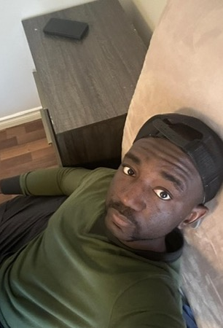
Background
Isaac Adebayo.
Reside in Canada for close to 20 years.
Have 2 siblings.

Slide 2
Education
University of Winnipeg
4 – year BSc Neuroscience
4 – year BA Psychology
University of Manitoba
3 – year BSc in General Science (Microbiology concentration)
University of Calgary
Open Studies: Pre-Master / Professional course requirements
Now: Meharry Medical College (MSc program, final semester ☺)

Slide 3
Work Experience: Current
Child and Youth Worker
Role: Goal is to use psychological principles and model to alleviate ACE/Trauma
Behavioral modification
Modify negative behavior such as (self harm and verbal outburst) and replace them with positive behavior
Harm reduction model
Acknowledge the role of addiction and offer support to reduce addictive behavior rather than stigmatizing
Incentive theory
Incentive driven application such as money incentive such as allowance to encourage life skills
Reinforcement
Positive reinforcement to improve positive behavior such as rewards (dinner/bus tickets) for completing a task

Slide 4
Work Experience: Past
Disability Practitioner
Social Skills
Community outing
Events could be trivia such as bowling, going to the gym, cinemas or major events such as
Social event based on their culture, background and religion
Pow-Wow for indigenous client
Life skills and Activities of Daily Living
Promote positive life skills like budgeting, cooking and cleaning skills
Administer medication, track narcotics count
Involved in ISP (individualized service plan) for my youth along with social worker, supervisor and PDD (person with developmental disorder) case- worker

Slide 5
Career Goal
Previous aspiration was to be a physician/surgeon. However, with the exorbitant amount of loans, 4-year residency onslaught that is highly stressful and lifestyle imbalance. I had a change of occupation.
Objective goals: Get into a PhD program in data science. My analysis show my ROI is high which take into consideration my previous academic background, glass ceiling, opportunity cost, stress level, lifestyle and hobbies
Subjective goals: Use Data science to address social economic disparity affecting the truly vulnerable individuals

Slide 6
Interesting fact and Hobbies
Play musical instrument
Active lifestyle
Play pickup sport at a high level
Personality: Intro-Extroversion.

